Slide 1
Starburst Galaxy Architecture
Technical Overview for Starburst Galaxy

Slide 2










An architecture for today and tomorrow
Trino cluster
Compute engine
True separation of storage and compute
Horizontally scales to meet demand by adding worker nodes and additional clusters
Cost-based optimizer automatically picks the join order with the lowest computed costs
Graceful shutdown API ensures worker nodes terminate without affecting running queries
Cluster scheduling and autoscaling to optimize compute utilization
Strict quality control on all Trino contributions
Coordinator node
Parse
BI & SQL Clients
Optimize
Metastore
Schedule
Data
storage
Worker
node
Add worker
node
Worker
node
Add worker
node
Notes:
The foundation of Starburst’s scalability is of course, Trino - an architecture for today, with the flexibility of tomorrow. Trino horizontally, or linearly, scales by adding worker nodes to extrapolate data where it resides, with a coordinator that schedules, optimizes, and parses queries for consumption. This compute is connected, but executed independently from the storage and BI & SQL clients tools as an intermediary for reading and transforming massive amounts of data in different locations.
Trino is extremely fast, on TB to PB of data. Additionally, Trino optimizes query performance through automatically picking the join order with the lower computed costs. Which brings up a good point. Scale doesn’t just mean size and speed. These are dials that can be turned up and down because of the architecture. Scale also includes cost, these are tangible infrastructure costs in addition to costs of compute. We strive to make Trino not only the fastest query engine on the market, but also the best-in-class price for performance engine. Meaning your prioritizing your compute costs to be the most impactful to the business. Another example of this is resource groups, which allows different groups of users to be prioritize with more, or less compute costs. It's like an all star mode for their most important data professionals.
Trino technically can auto scale, but this would involve significant effort and expertise to accomplish. It is not something a typical OS Trino administrator would do and would look to Starburst for auto scaling. Trino does, however, include a graceful shutdown API that ensures worker nodes terminate without affecting running queries
On top of all this, is the strict quality control on all Trino contributions. Maintaining clean code and contributions to our software means a better experience for our customers scale, and our ability to grow with them.

Slide 3
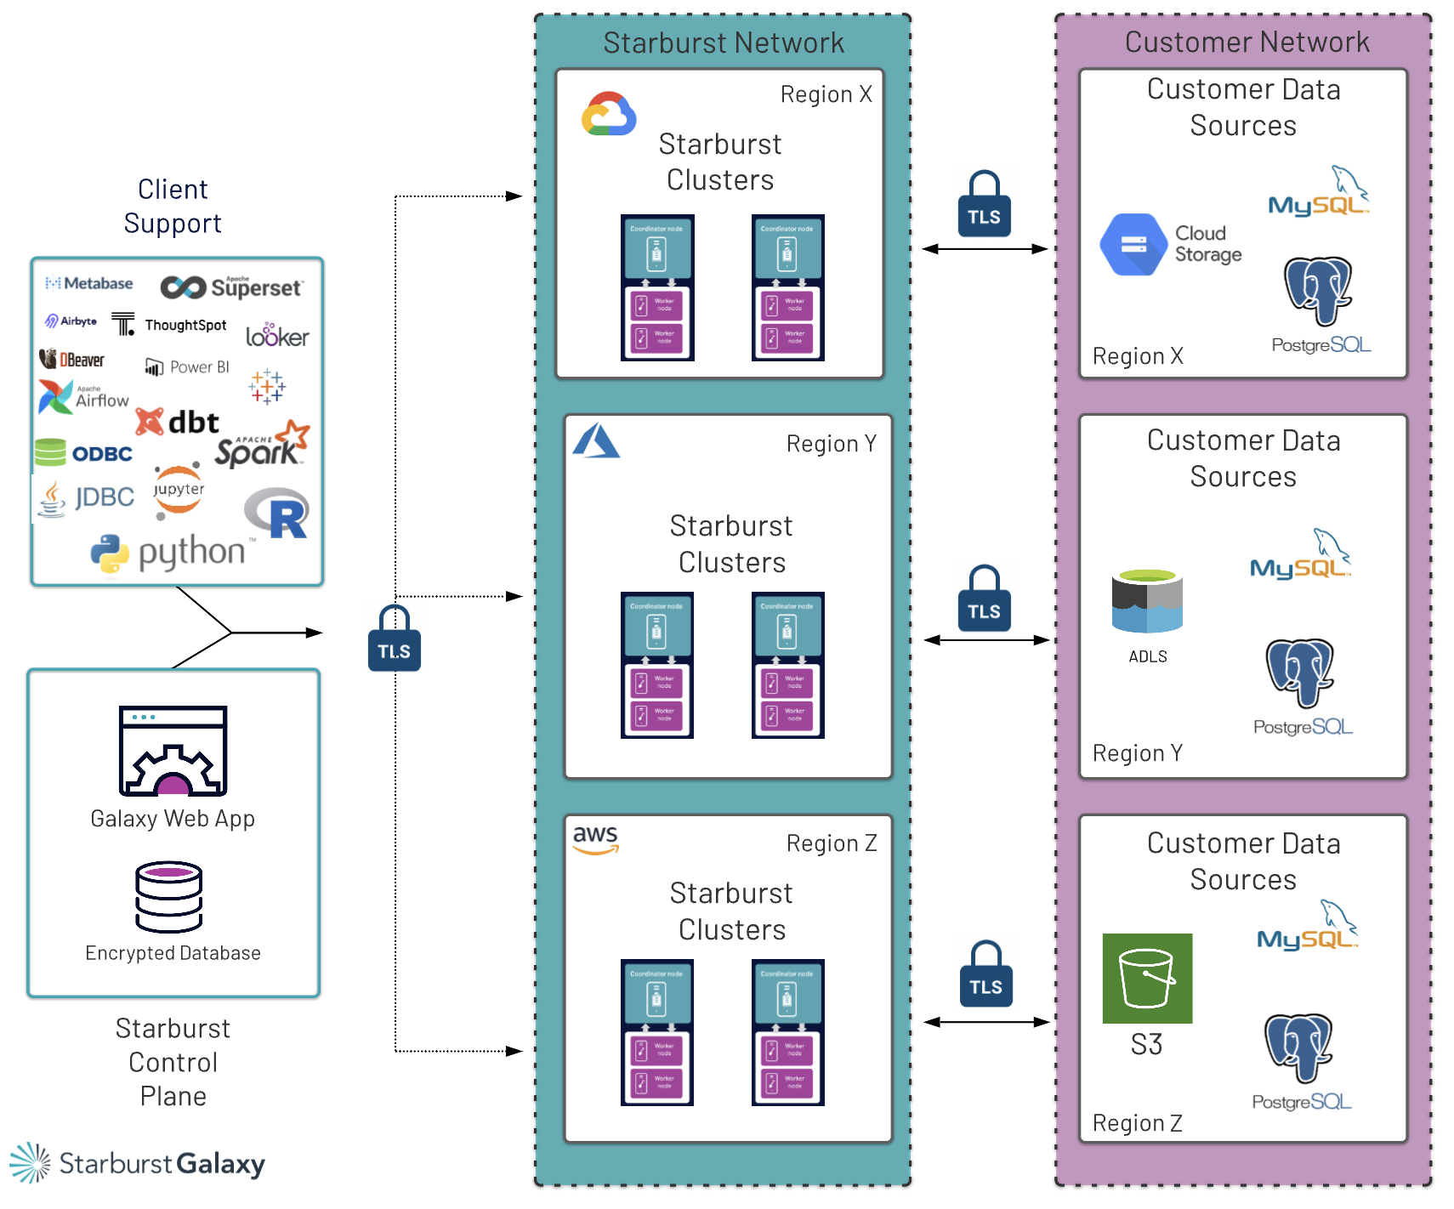
Starburst Galaxy - Architecture
Compute in Starburst Network
Allows for suspension and faster deployment of clusters
Clusters deployed in region where the data lives
Blue/Green - seamless to end users for changes/upgrades
Deploy via control plane to all 3 clouds

Slide 4
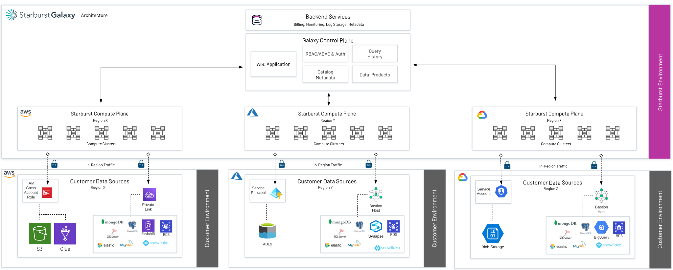
Starburst Galaxy - Architecture

Slide 5
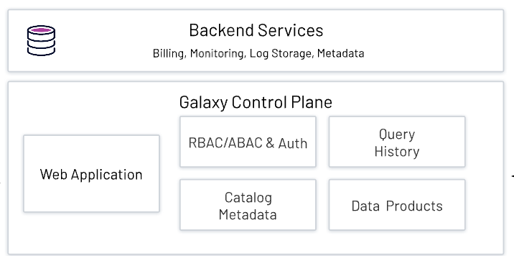

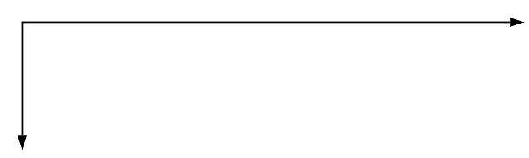
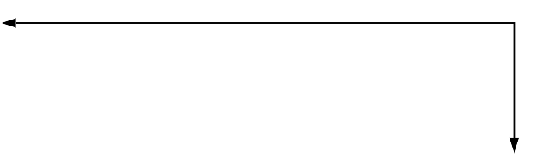

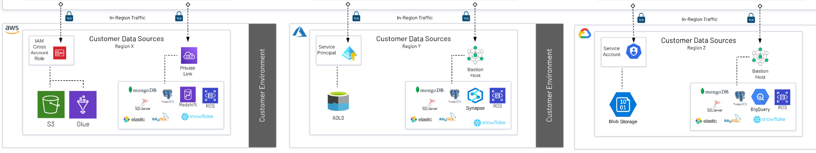

Starburst Galaxy - Architecture

Slide 6
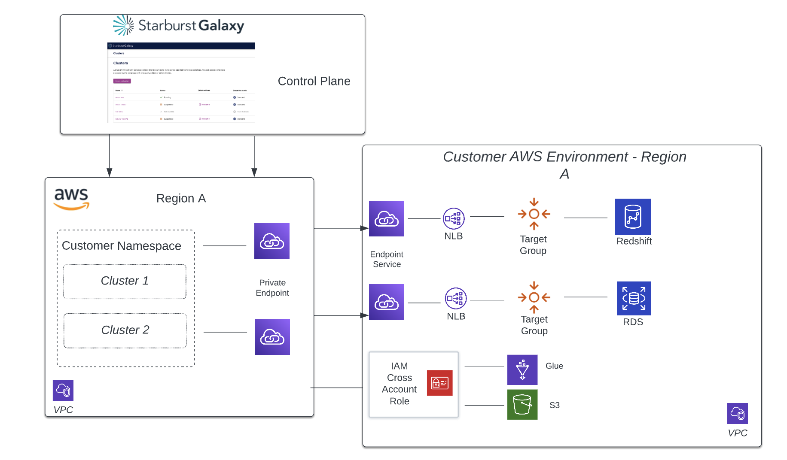
Catalog Auth Methods - Private Link
Direct Private Endpoint connection between Galaxy Clusters and Customers Data Sources
Ensures secure access without exposing data source to the public internet
A more secure alternative to using a bastion host
Docs: https://docs.starburst.io/starburst-galaxy/security/privatelink.html

Slide 7
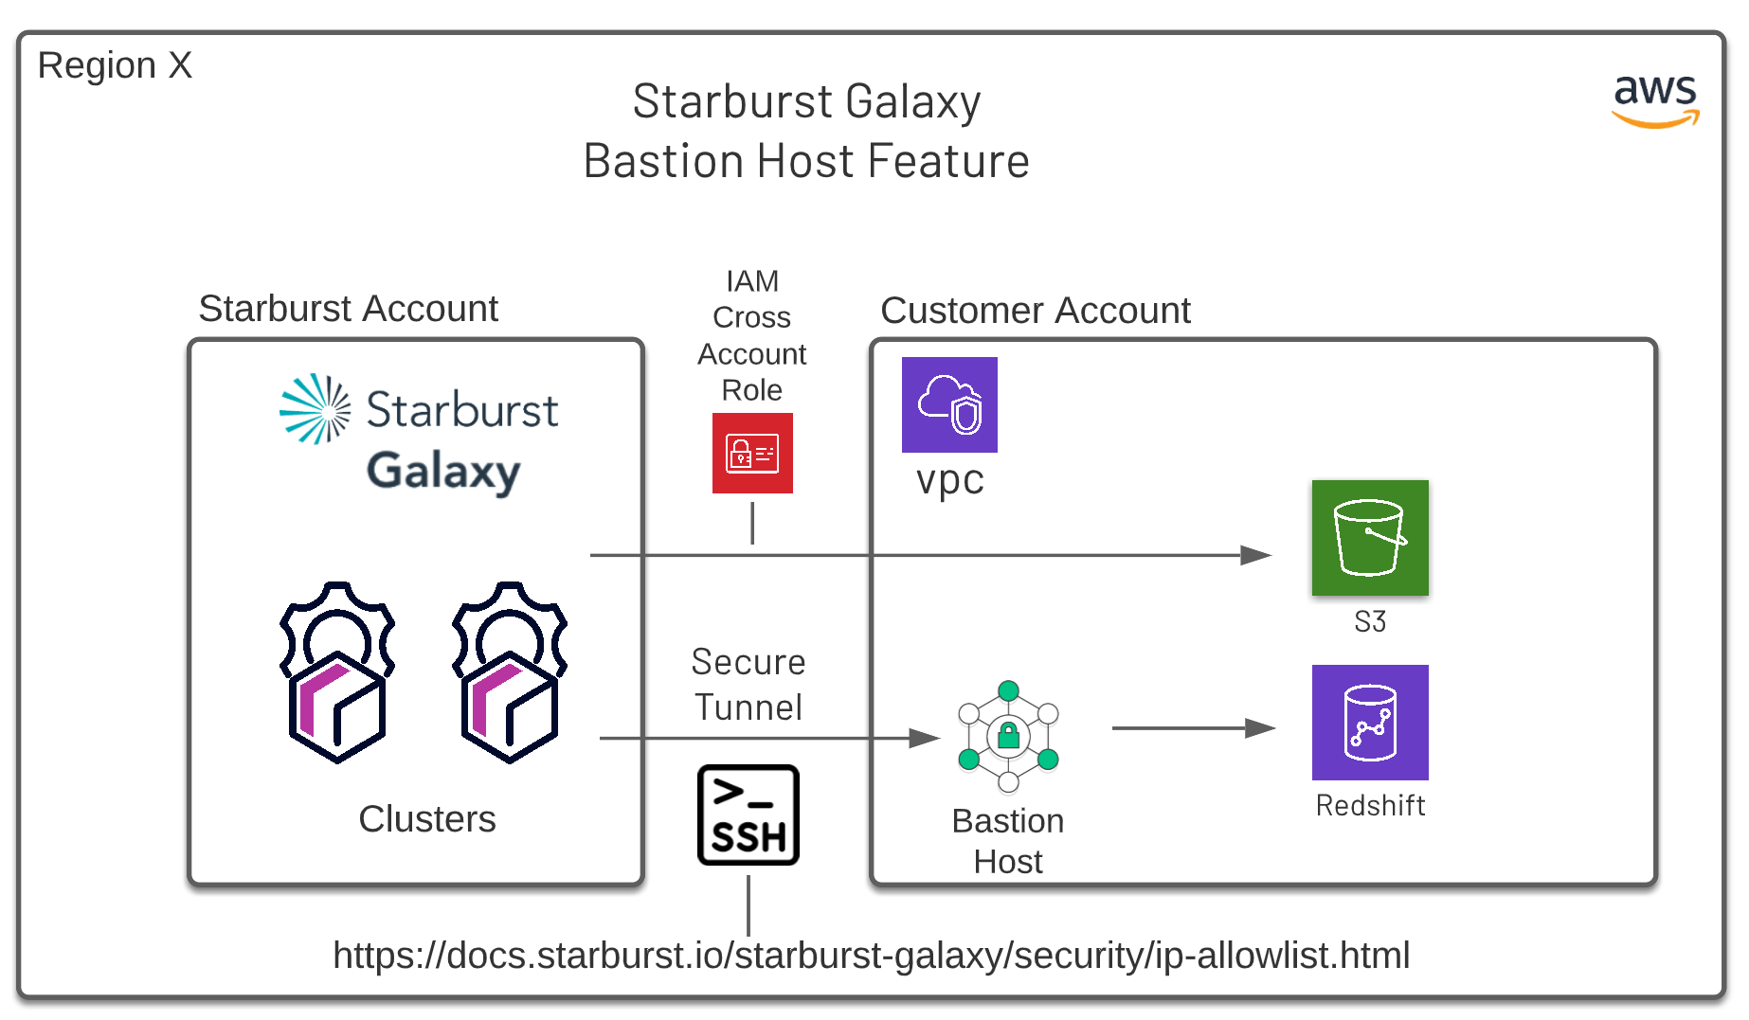
Catalog Auth Methods - Bastion Host
Bastion host running Linux and ssh
Allow list for Galaxy applied to Bastion host
Bastion host can be used to access multiple data sources

